Slide 1
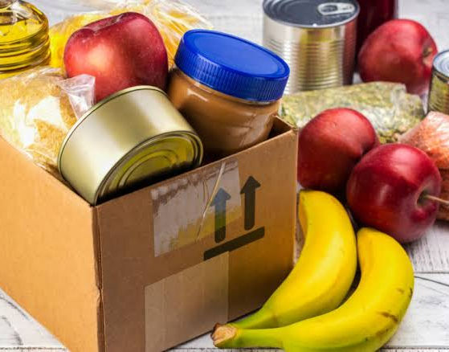
AN APP FOR FOOD WASTAGE REDUCTION BY DONATION
Shraddha Kshirsagar
A-61
(GR.NO.-11810662)
-Guided by
Prof (Dr.)Shripad Bhatlawande

Slide 2
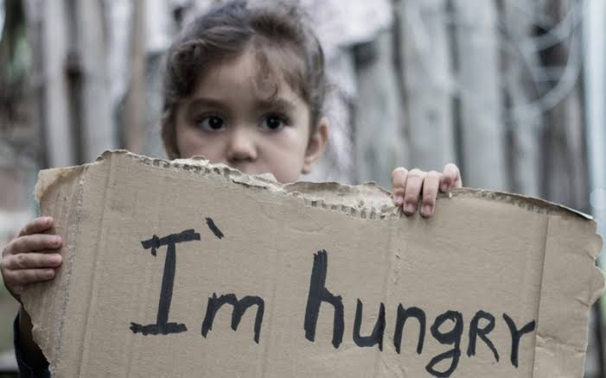
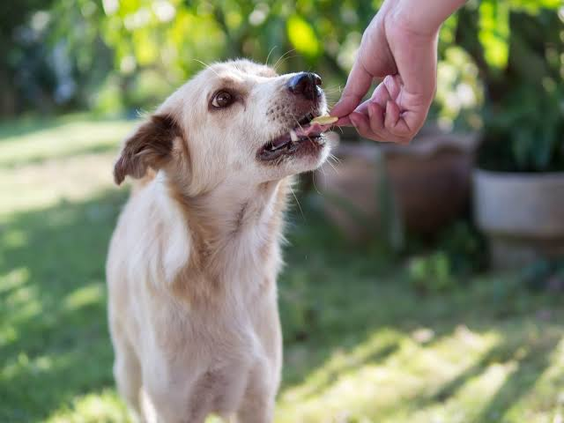
INTRODUCTION
Food Wastage is disturbing issue
Need of Food Donation
An App To make food donation easier
Reduction in Food Wastage
To Feed the hunger

Slide 3



Software Required:-
Android Studio(Java)
Firebase

Slide 4
ACTUAL FLOW
Upload food details with picture
Donor
User Registration
Recipient
Contact Donor by receiving donor’s details

Slide 5
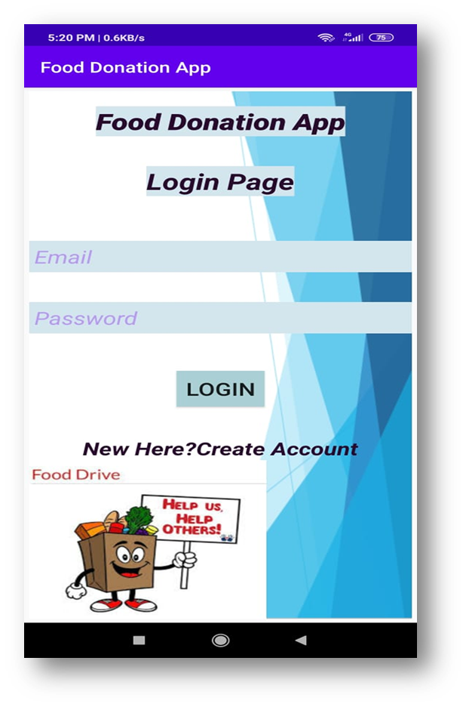
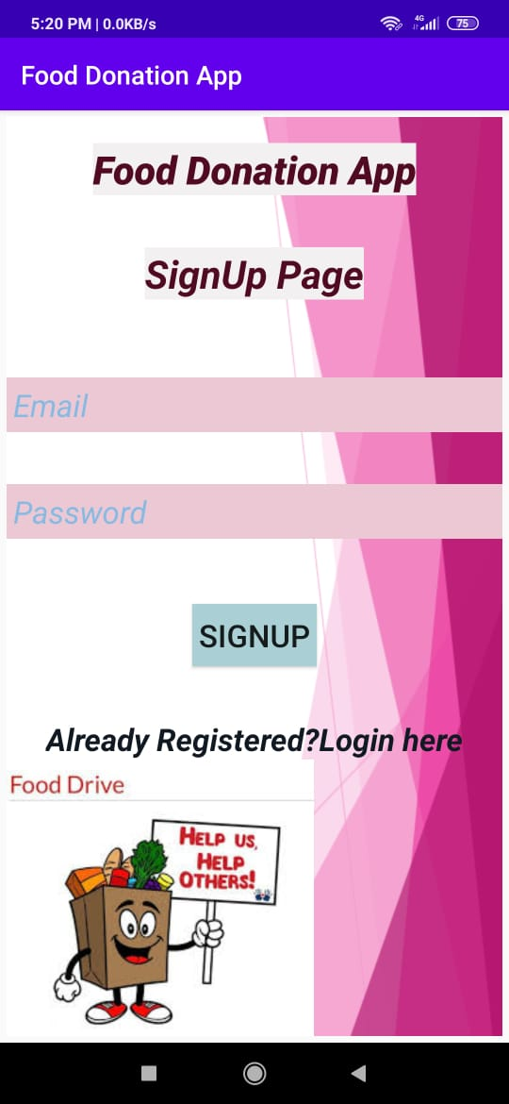
STRUCTURE
Login and Signup activity page for authentication:-
LOGIN ACTIVITY PAGE
SIGNUP ACTIVITY PAGE

Slide 6
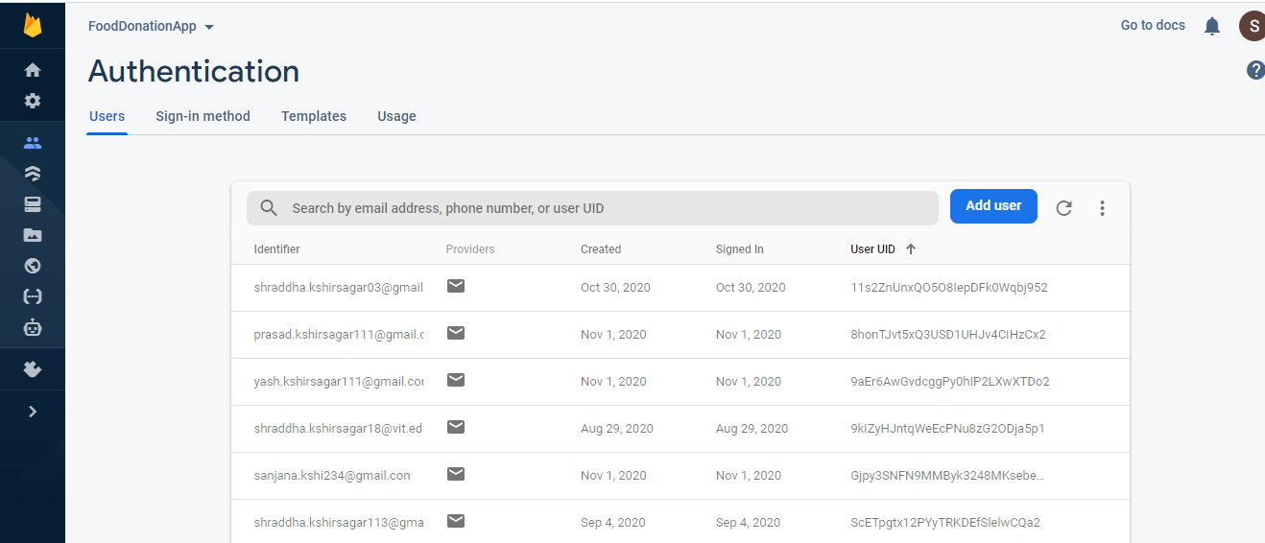
FIREBASE AUTHENTICATION
User Registration using email & password

Slide 7
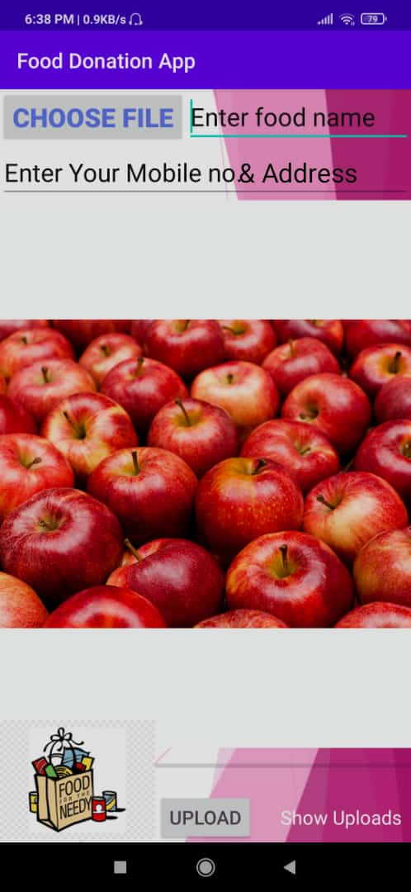
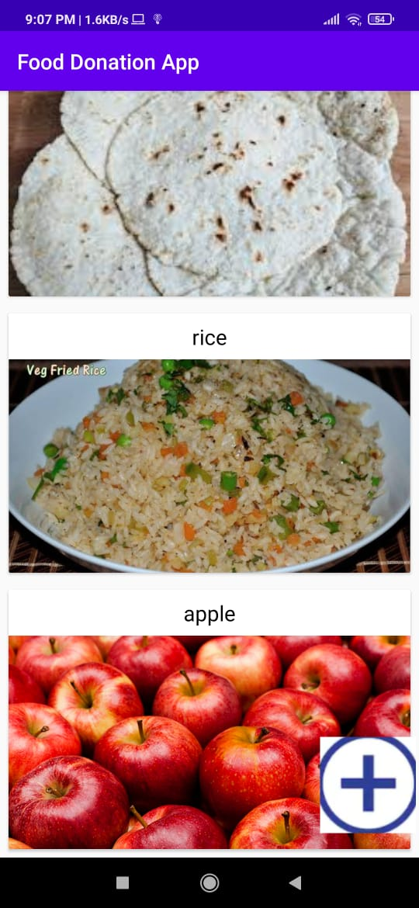
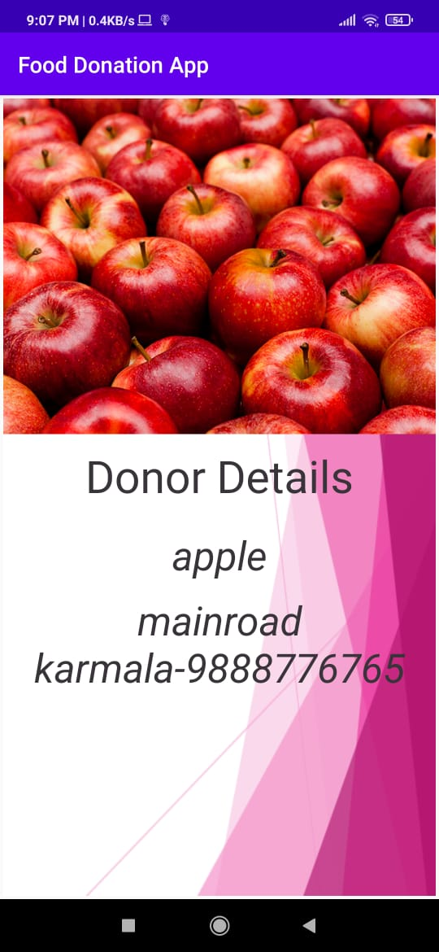
WORKING
Upload Activity Page
Home Page
Food’s Details

Slide 8
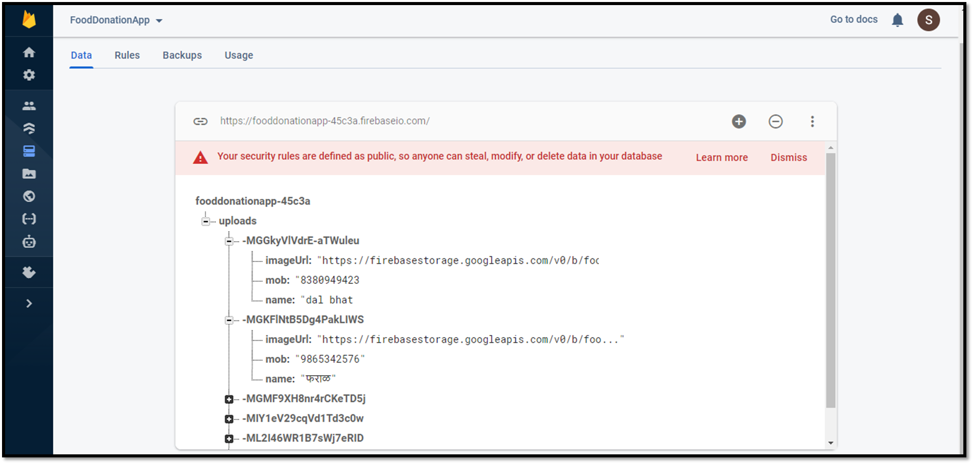
FIREBASE DATABASE

Slide 9
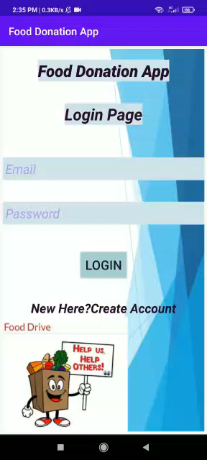

Slide 10

LIMITATIONS
Users should have Smart Phone
Good Network Connectivity

Slide 11
THANK YOU!

